Slide 1
SETUP
Connect to MQTT Broker
Subscribe to Server Topic
ReadyToTake Variable set to FALSE
Wait for Server-side ACK JSON with register info
Device initialized as prescription/”free tracking”
MAIN LOOP
CALLBACK
Server-side Interrupt
Reads in JSON, sets ReadyToTake Variable as True
True
ReadyToTake == True
False
State 0:
Read if pill bottle is present via. Sensor
Green LED
State 4:
Read if pill bottle is present via. Sensor
Purple LED
Alert!
Alert is sent to database and recorded, then shown on webpage
Red LED
Bottle is present
Bottle no longer present
Bottle is not present
Instant Transition
State 5:
Start a timer
DO NOTHING ☺!
State 1:
Start a timer
Bottle does not return in 30 seconds
Instant Transition
Bottle does not return in 30 seconds
Bottle is returned
State 3:
JSON message is sent to server with time of intake (when the bottle is returned)
ReadyToTake set to FALSE
State 6:
Wait for bottle to return
State 2:
Wait for bottle to return
Yellow LED
Bottle is returned

Slide 2
Prescription
Free Tracking
User enters the following information
Time of Prescription Intake (9am, 4pm)
Frequency (Daily, Biweekly)
Prescription Amount (# of pills)
Prescription Name (Tylenol)
Server keeps track of when user should take medicine
When it is time →
Sends JSON callback
Controller starts recording for medicine intake
Server stores time of intake into database
User enters the following information:
Prescription Name (Tylenol)
Server only tracks when user takes medicine
Controller can start recording for medicine intake at any point
Server stores time of intake into database

Slide 3



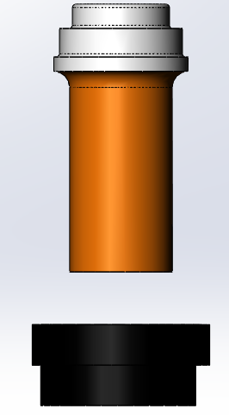
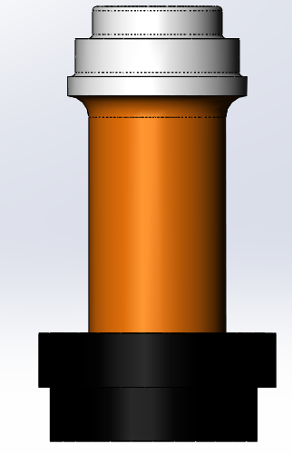
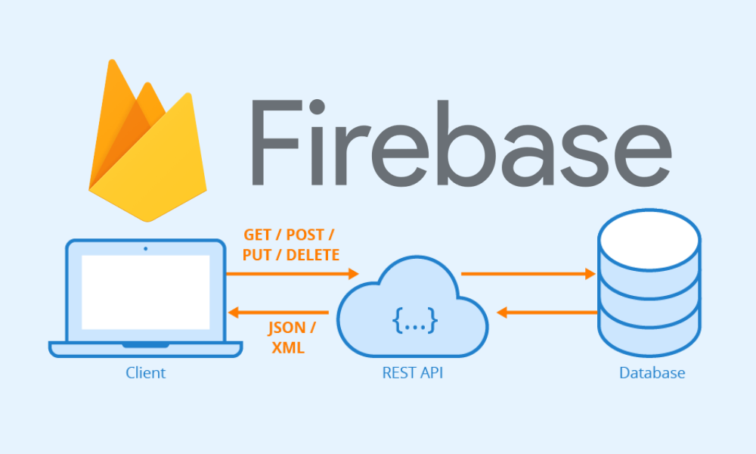

User enters their prescription information
Server keeps track of when user should take medicine
User is notified to take medicine
Pill bottle is taken off MedMate
Pills are consumed and bottle is put back on MedMate
Time of Intake is uploaded to Database
Patient History shown on Webpage

Slide 4
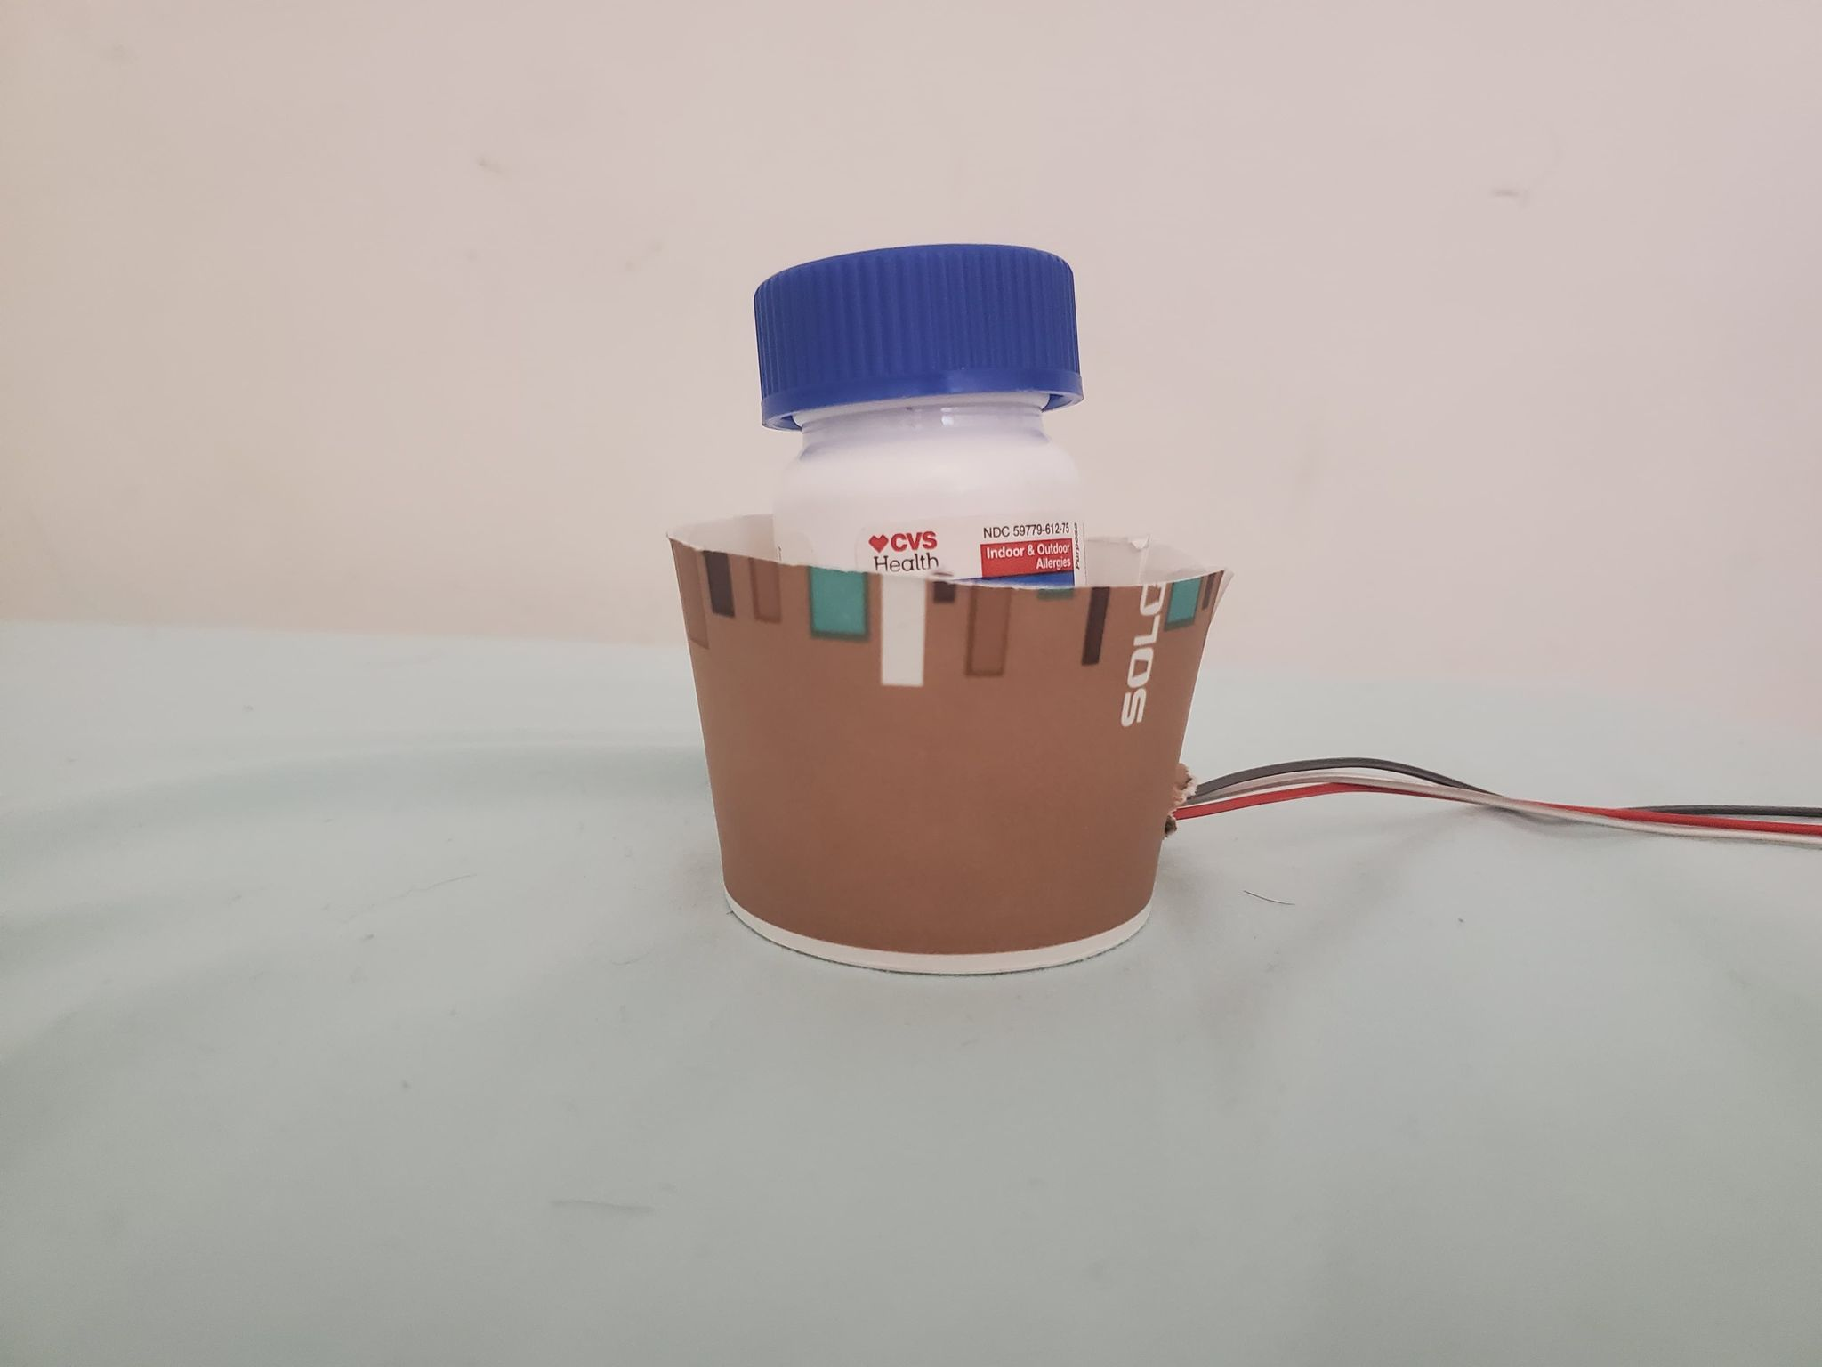
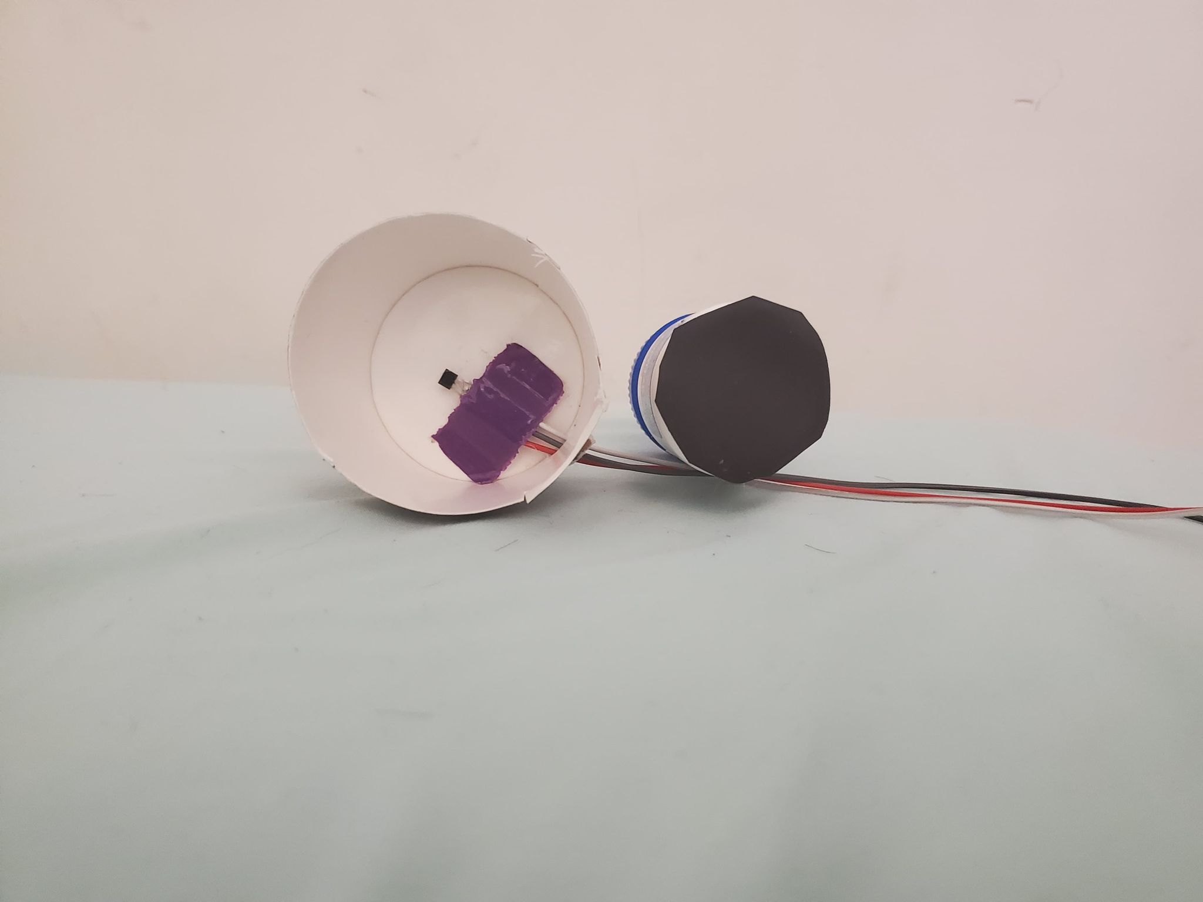
Pill Bottle
Paper Cup
DRV5053 Hall Sensor
Magnet

Slide 5
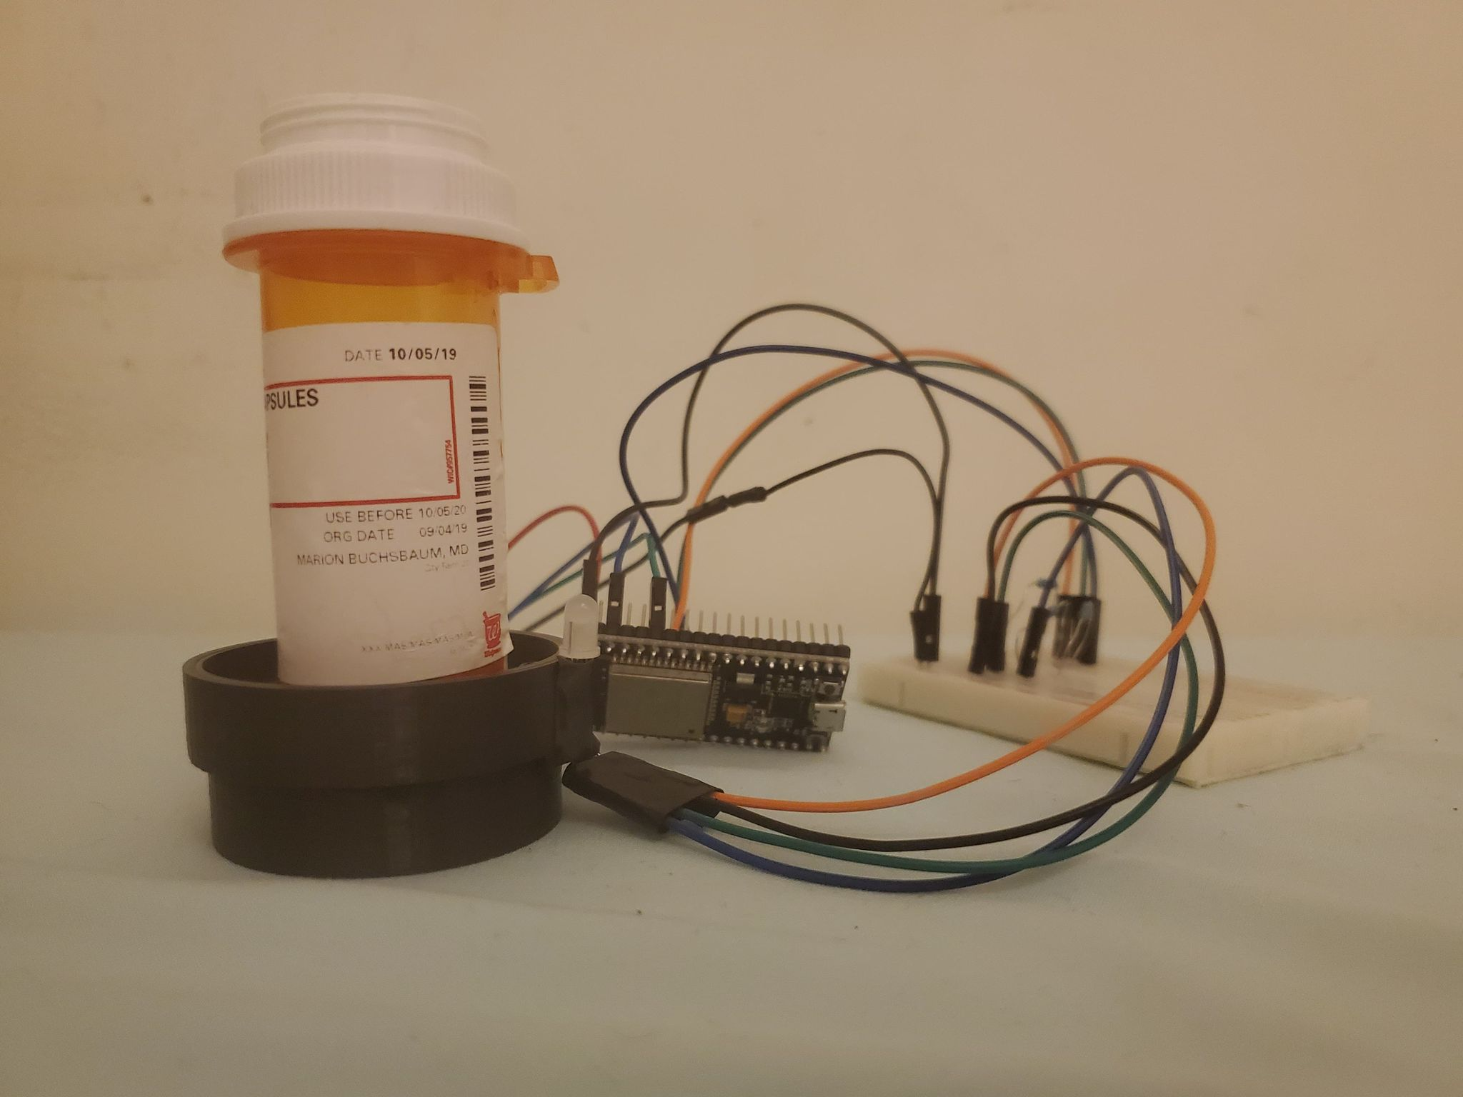
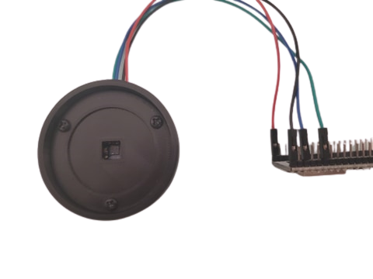
Pill Bottle
VCNL4010 Proximity Sensor
MedMate
Multicolor LED
ESP32

Slide 6
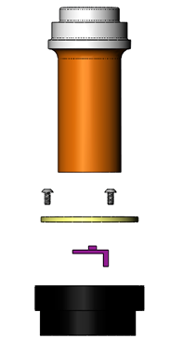

Pill Bottle
M3 Screws
Top Lid
VCNL4010 Proximity Sensor
Multicolor LED
Main Housing

Slide 7
ESP32
VCNL4010
SCL (P22)
SDA (P21)
SCL
SDA
GND
GND
3.3V
3.3V
Red (P32)
Multicolor LED
220Ω
Green (P33)
Red
220Ω
Blue (P25)
Green
GND
220Ω
Blue

Slide 8
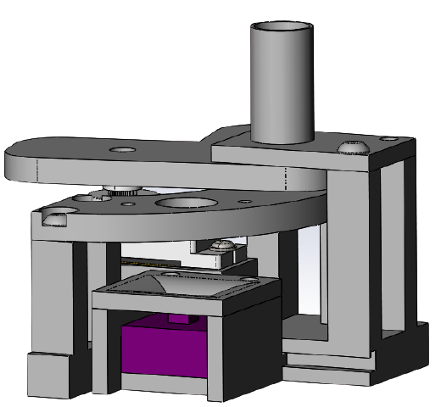
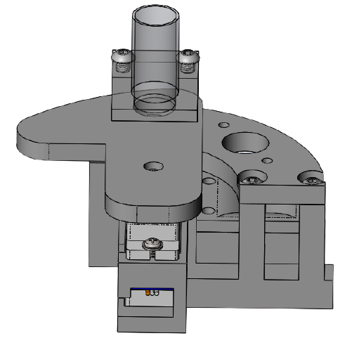
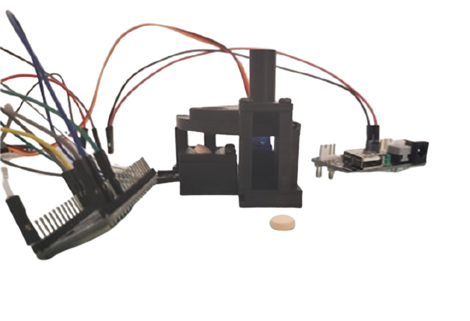
Pill Tube
Rotating Cam
Sorting Piece
Pill
Pill Holder
SG90 Servo
VCNL4010 Proximity Sensor
Pill

Slide 9
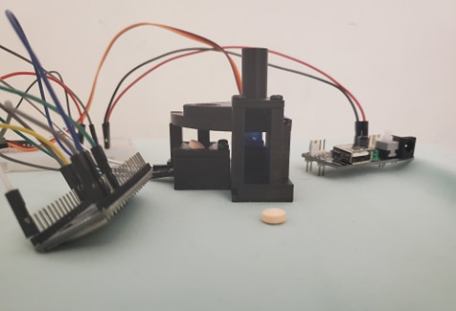
Pill Dispenser
SG90 Servo
5V Power Supply
Pill
ESP32

Slide 10
ESP32
VCNL4010
SCL (P22)
SDA (P21)
SCL
SDA
GND
GND
3.3V
3.3V
SG90 Servo
P13 (PWM)
PWM
5V Power Supply
GND
GND
5V
5V

Slide 11
Pill Dispenser State Machine
SETUP
Connect to MQTT Broker
Subscribe to Server Topic
ReadyToTake Variable set to FALSE
Wait for Server-side ACK JSON with register info
Device initialized as prescription
MAIN LOOP
ReadyToTake == True
CALLBACK
Server-side Interrupt
Reads in JSON, sets ReadyToTake Variable as True, sets # of pills to dispense
True
State 0:
# of Pills are dispensed
False
State 1:
Check to see if pills are still in pill holder
Wait for Callback
State 3:
JSON message is sent to server with time of intake
ReadyToTake set to FALSE
Instant Transition
Pills are taken off holder

